Slide 1
Final Project Report CSCE 5320
VENKATA SAI BHARGAVA REDDY

Slide 2

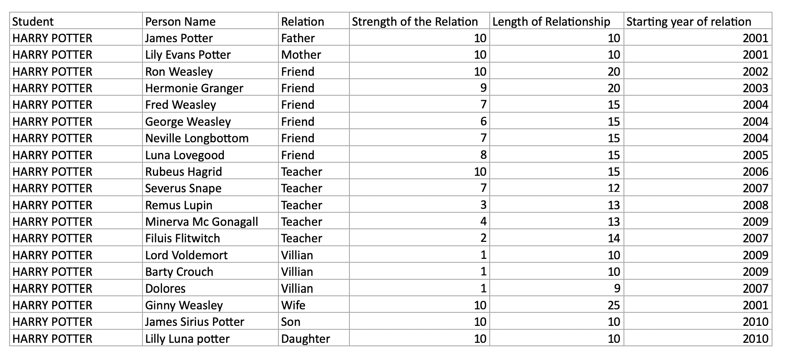

PART 1 : Multivariate Data Visualization – Graphs

Slide 3
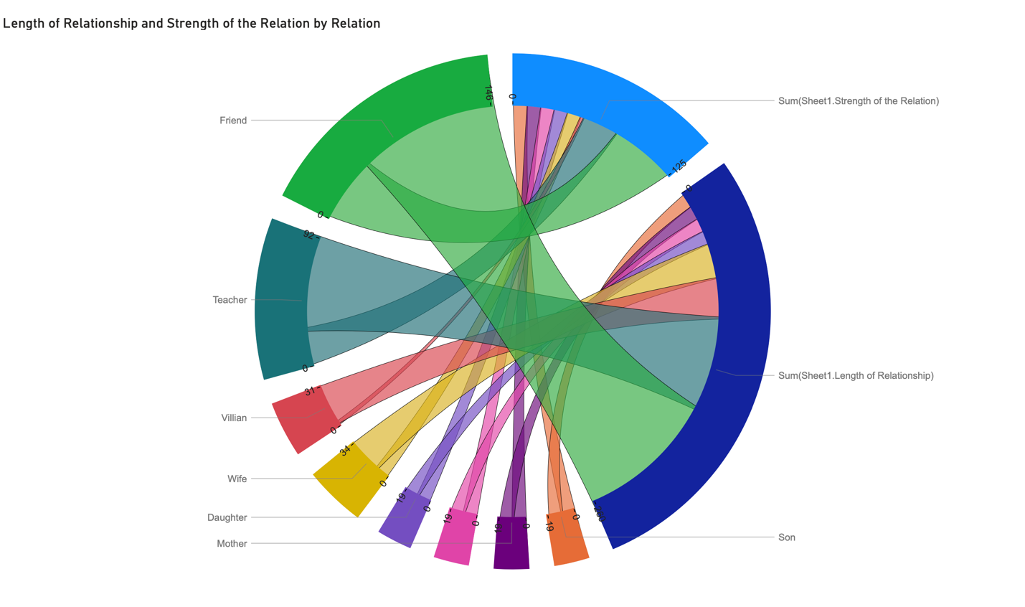

CHORD DIAGRAM

Slide 4
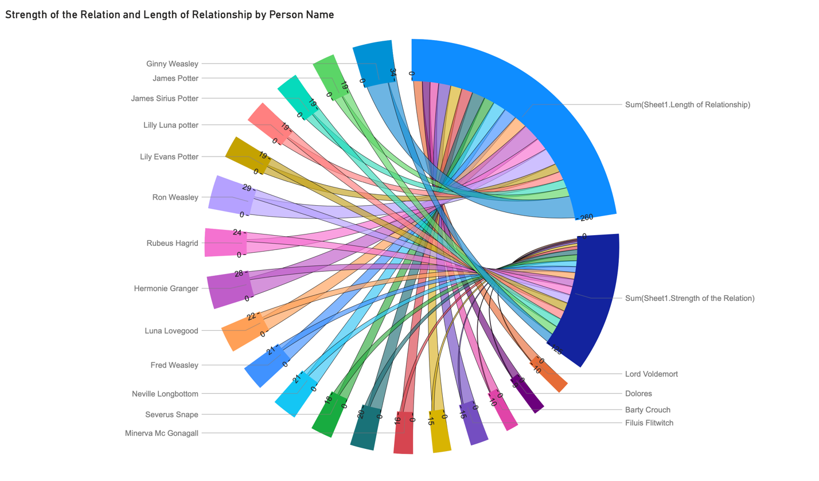
CONT..

Slide 5
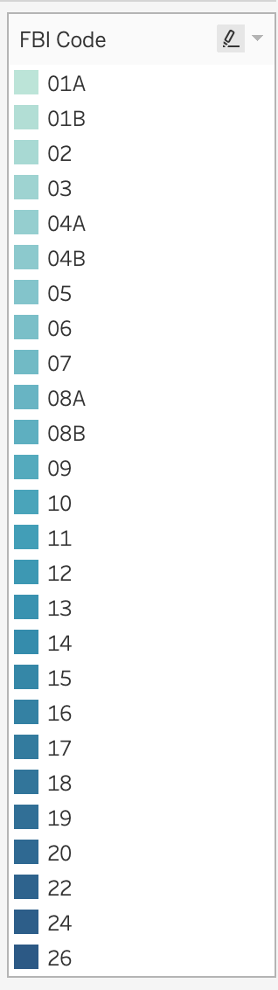
PART 2:Exploring a Large Dataset with Tableau
What are the FBI codes?

Slide 6
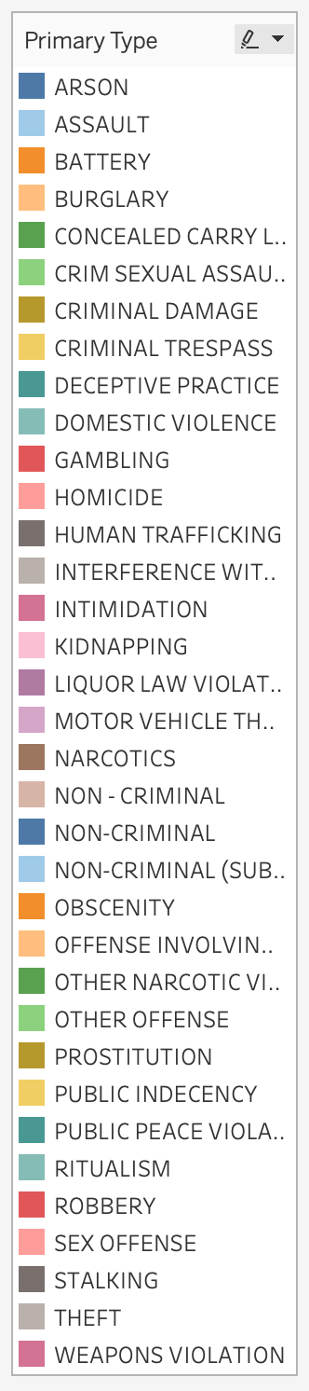
What are the primary types of crimes?

Slide 7
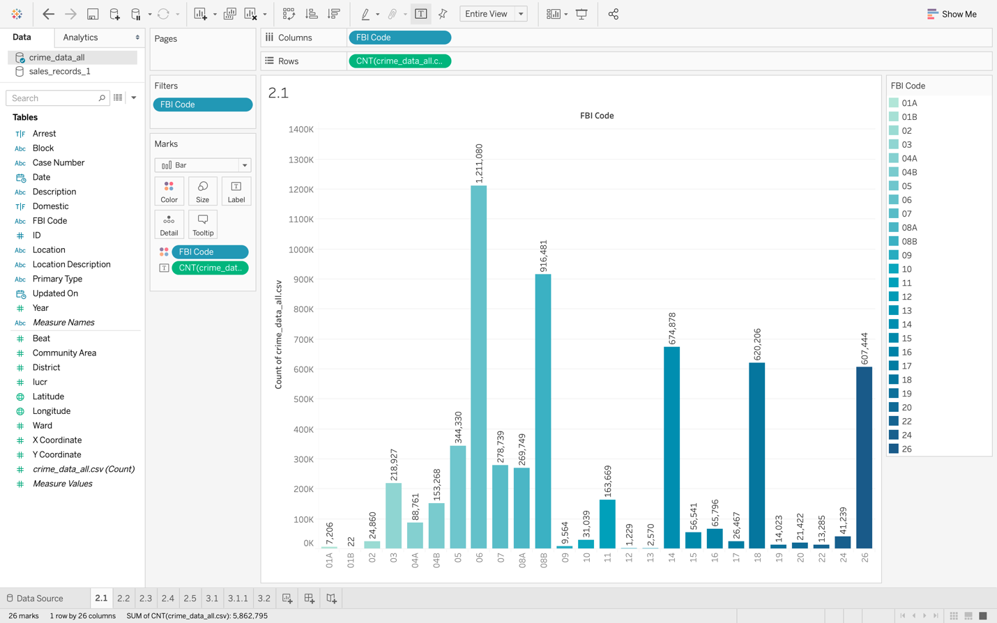
The total number of criminal cases for each FBI code collected in a dataset?

Slide 8
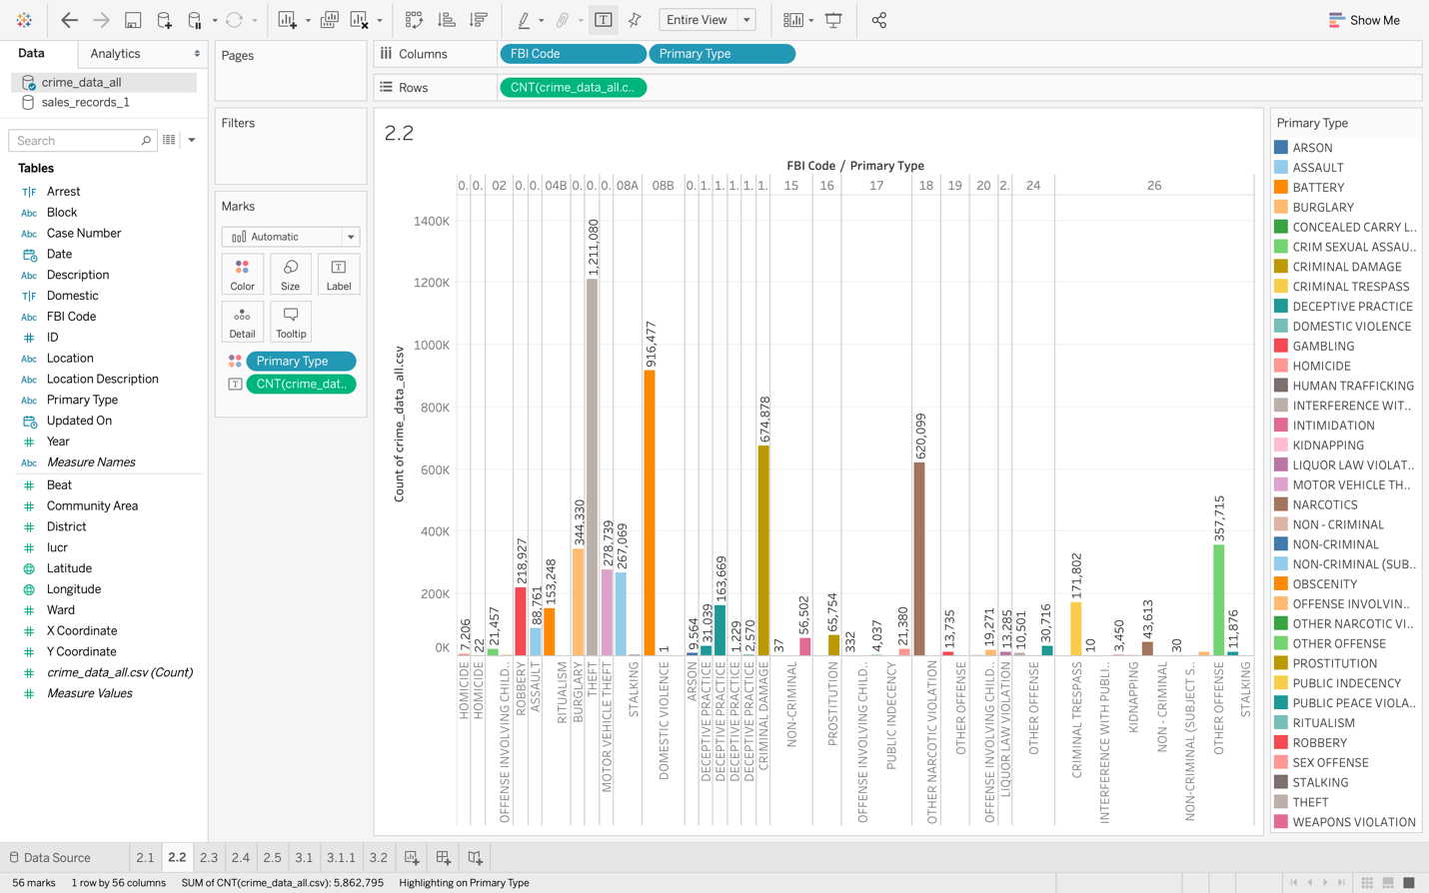
The total number of criminal cases for each primary type of crime collected in the dataset?

Slide 9
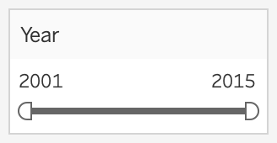
The period that the data has been collected?

Slide 10
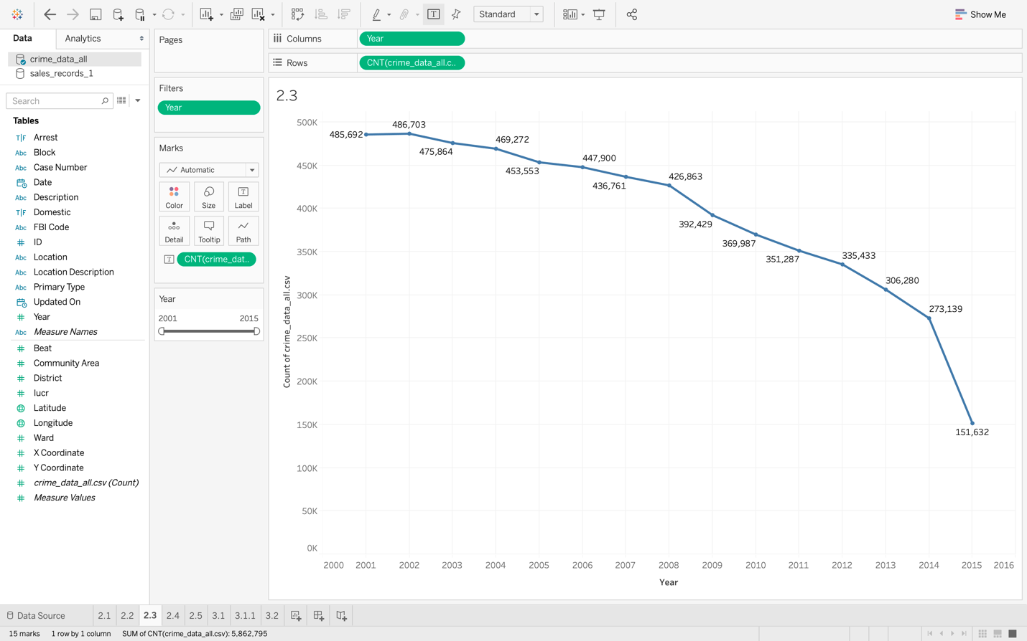
The trend of committing a crime in the USA during this period?

Slide 11
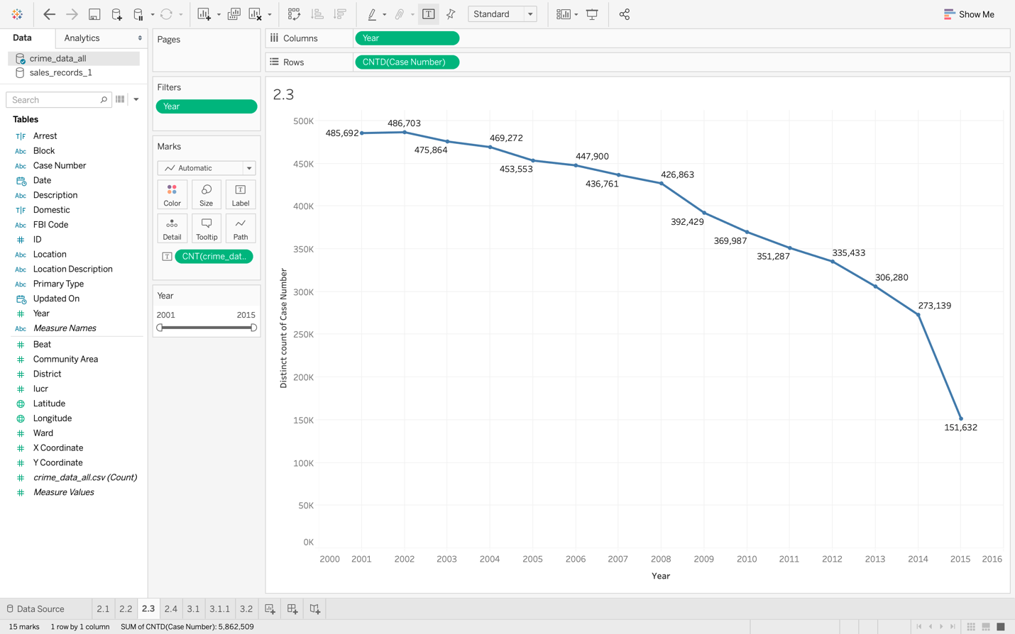
In Tableau, Case Number is classified initially as a dimension. This variable would be much more helpful in the EDA if it is converted into a measure.

Slide 12
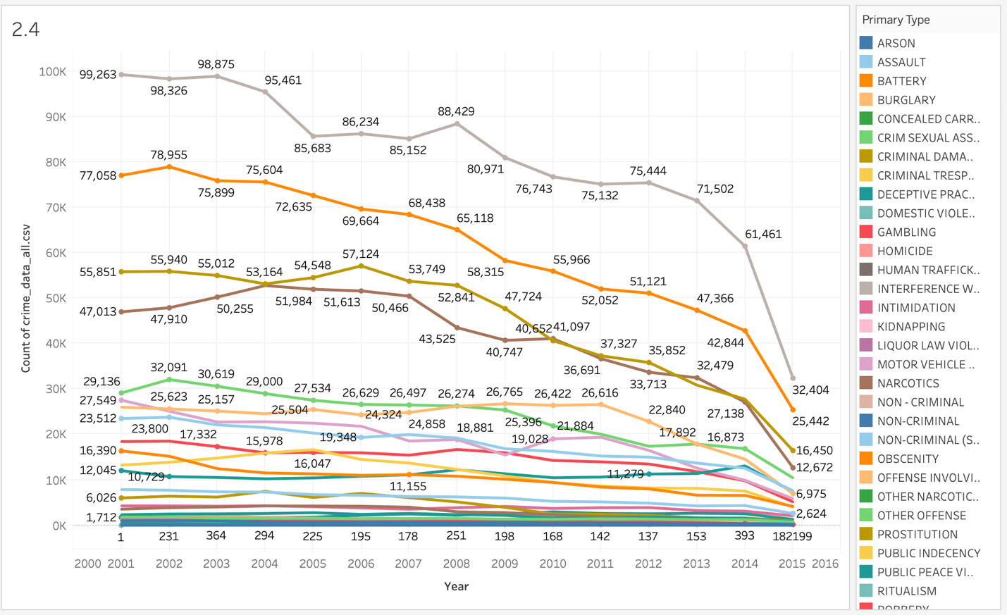
CONT..

Slide 13
PART 3:Data Visualization with Tableau
SCATTER PLOT

Slide 14
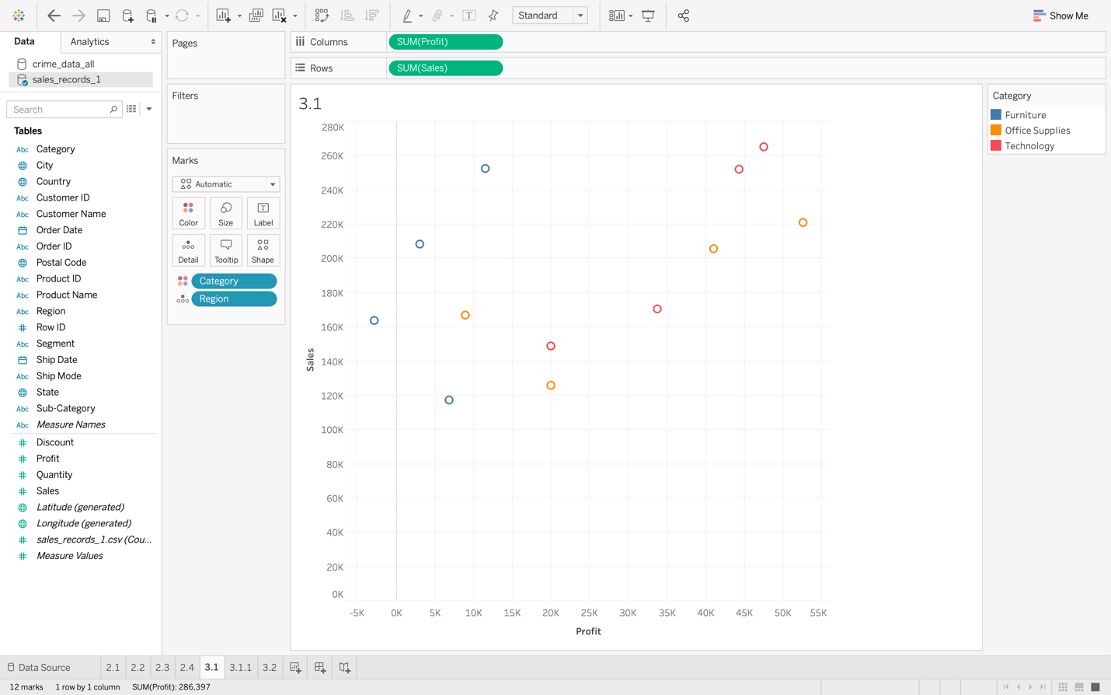
3.1

Slide 15
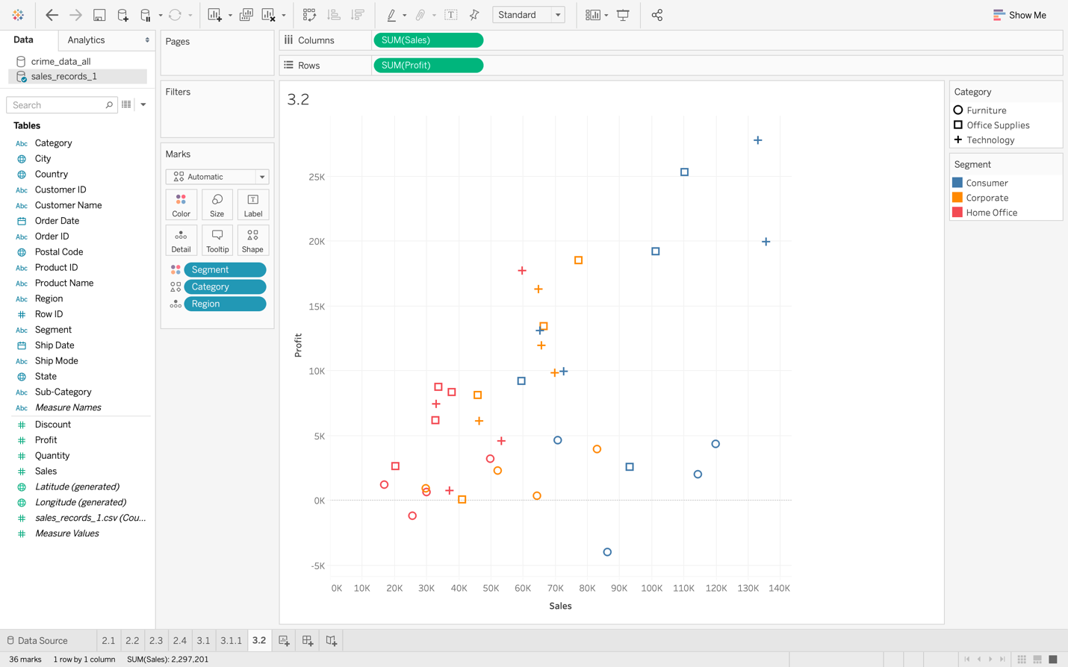
3.2

Slide 16
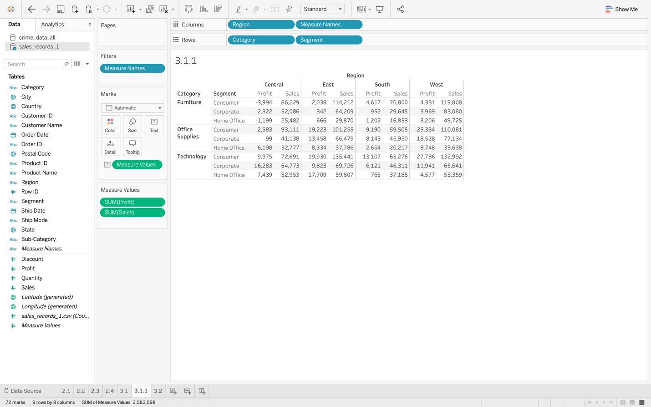
CONT..

Slide 17
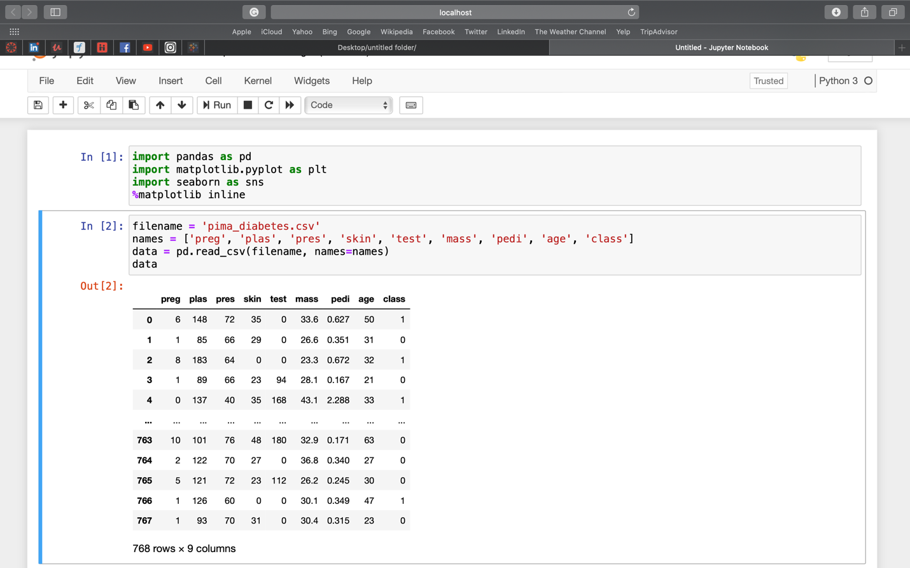
PART 4:DATA VISUALIZATION WITH PYTHON PANDAS AND MATPLOTIB

Slide 18
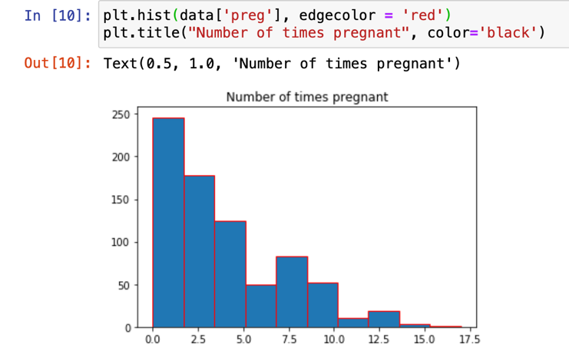
4.2

Slide 19
CONTINUE IN JUPYTER NOTEBOOK

